Slide 1

DDS Attrition Analysis
Team DataTex

Slide 2

Introduction
DDSAnalytics: Using Data to Solve Problems
Solutions for Fortune 1000 Companies
Workforce Planning
Employee Training Program
Identifying High-Potential Employees
Reducing Turnover
Data Interpretation
Notes:
DDSAnalytics is a Data Analytics company that reviews company data to provide insights and offer solutions.

Slide 3
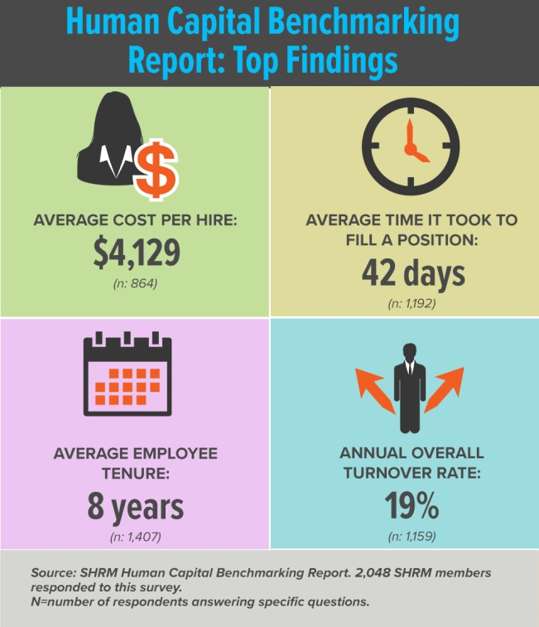

Cost of Attrition - 2016
Costs Per Hire $4,129
Time to Fill 42 days
Employee Tenure 8 Years
Annual Turnover Rate 19%
Notes:
Currently ACME’s Employee Tenure is estimated at 7 Years and Annual Turnover Rate at 16%

Slide 4
Exploratory Data Analysis

Slide 5
Naïve-Bais

Slide 6
Backward Selection

Slide 7
Logistic Regression

Slide 8
Other Findings

Slide 9
Conclusions
Top 3 Factors that Contribute to Turnover

